Slide 1
Vast Mini Challenge 1

Slide 2
Welcome
Welcome Mistford resident!
We live in a unique town next to Boonsong Lekagul Nature Preserve
We have an industrial giant Kasios
And Mitsford College

Slide 3
Boonsong Lekagul Nature Preserve
When was the last time you went to the Park?
Interactive response for people to enter when
Interactive response for people to enter why

Slide 4
Bird Calling
Well, so far only X% of you went for bird calling

Slide 5
But did you notice the Pipit?
Rose-Crested Blue Pipit
This is our town’s adopted favorite bird
Pictures of the town appreciating Pipet

Slide 6
Did you see the Pipit when you were at the Park?
Interactive response if they saw the Pipet or not

Slide 7
Mini-challenge 1 response
Do you detect any trends or anomalies in the patterns? Please limit your answer to 10 images and 1000 words.
Location trends
Time trends
Bird types

Slide 8
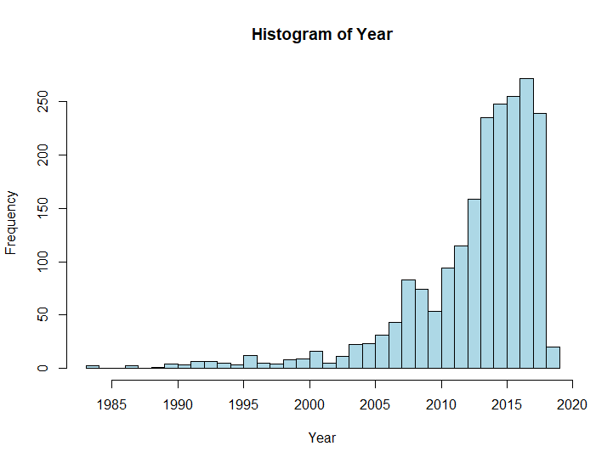
Over the past 35 years, we saw

Slide 9
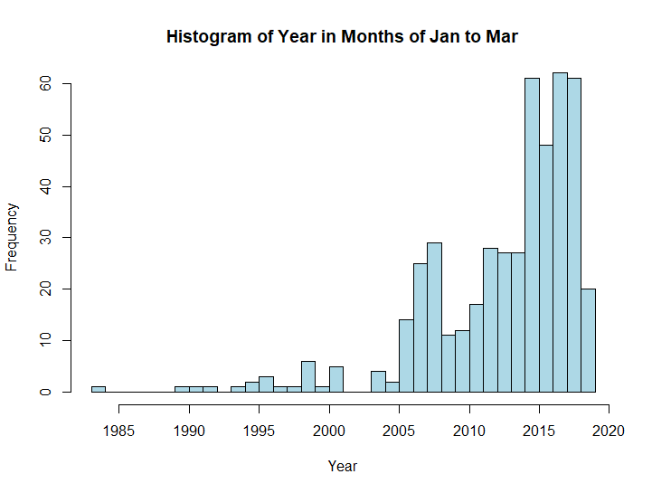
Vis 2

Slide 10
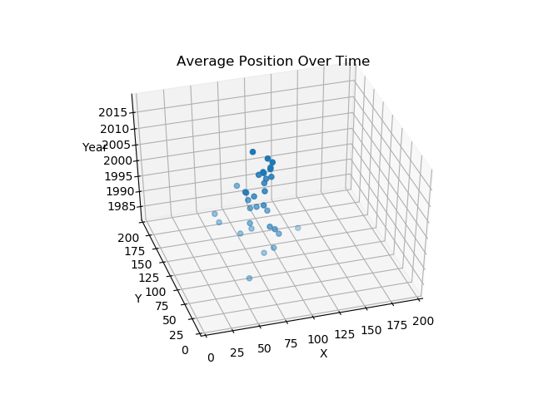
Vis 3

Slide 11
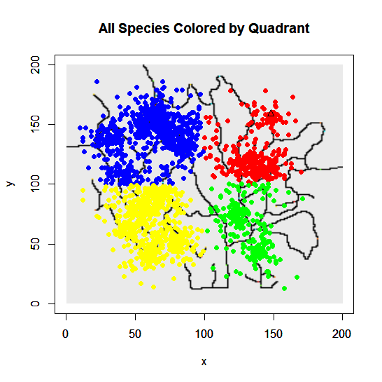
Vis 4

Slide 12
Vis 4
Basically all of Andrew’s findings

Slide 13
Vis 5

Slide 14
Vis 6

Slide 15
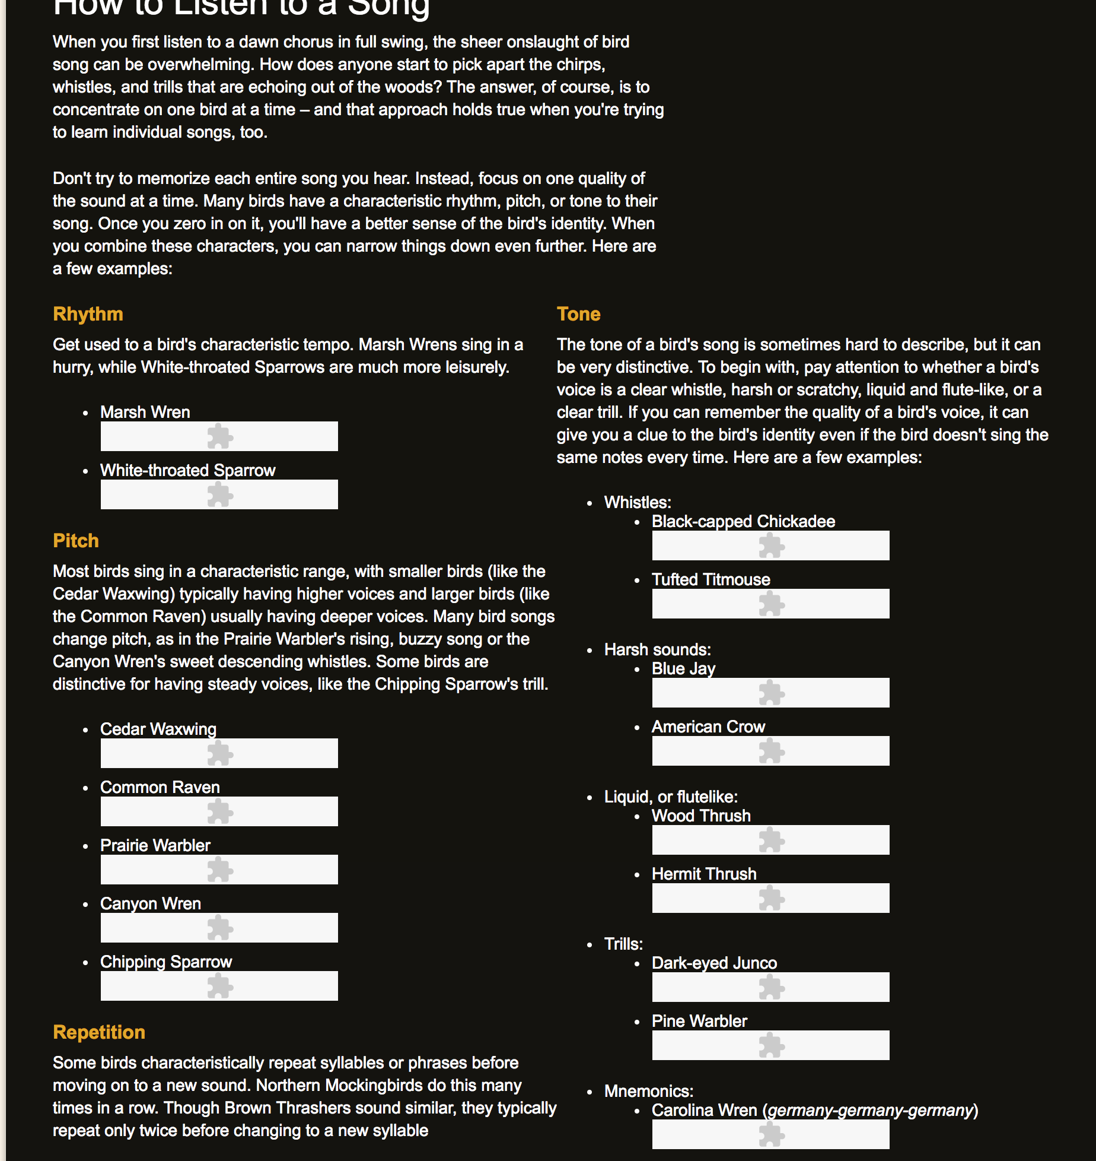
How to listen to bird calls
http://www.birds.cornell.edu/Page.aspx%3Fpid%3D1059
https://experiments.withgoogle.com/ai/bird-sounds/view/

Slide 16
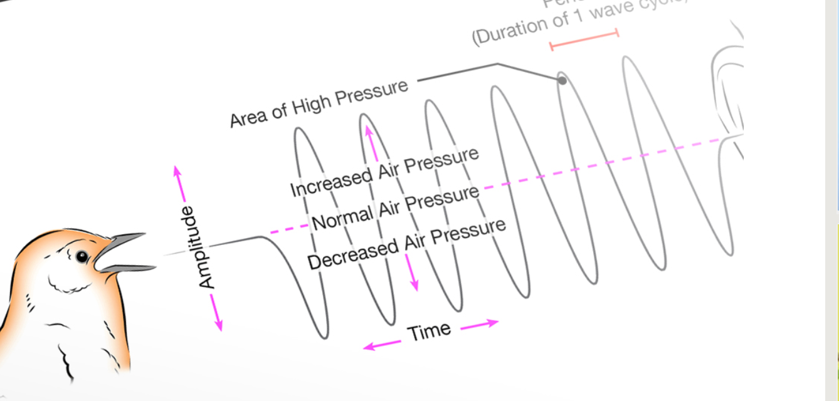
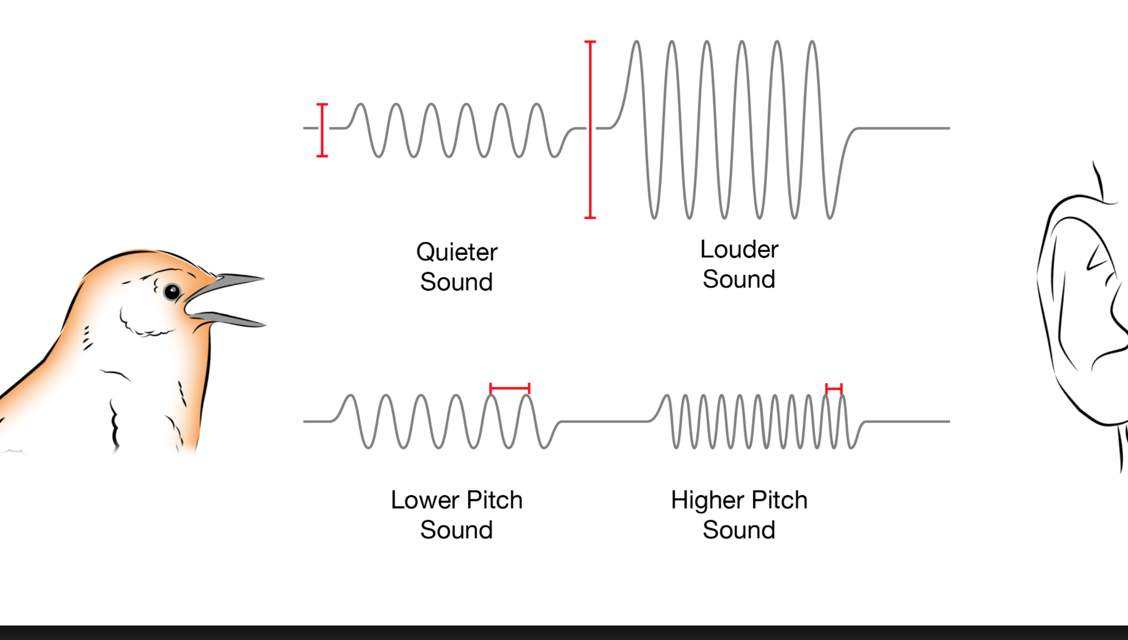
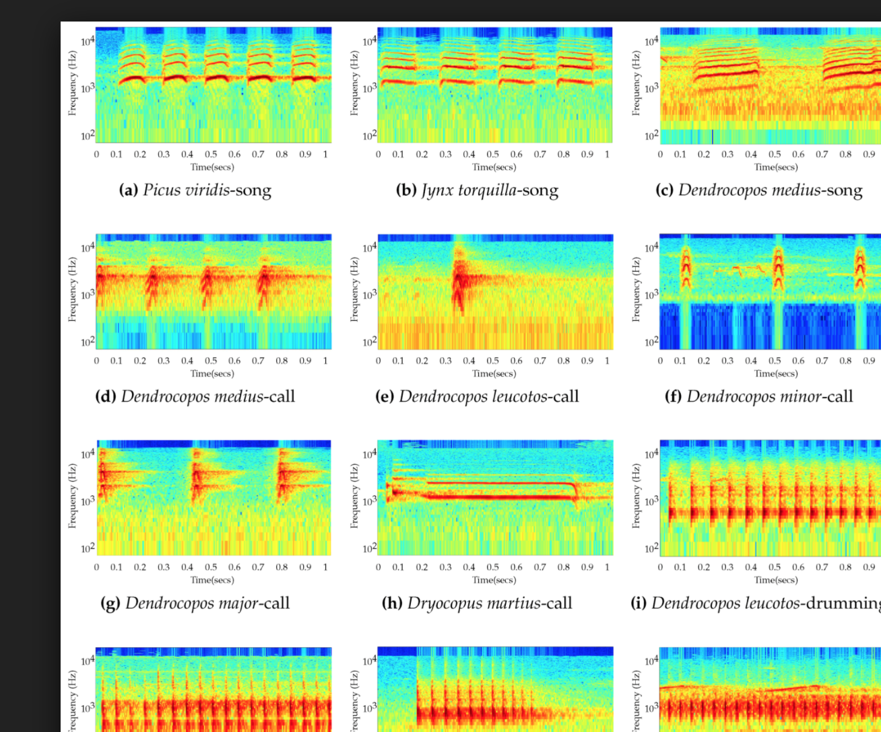

Slide 17
Kasios has presented this…
Interactive have you heard the bird sounds?

Slide 18
Here are some birds in the area and how they sound:
Interaction to click a bird name and hear its sound, see its sound with the visualizations
Sameera and Cyrill’s audio visualizations

Slide 19
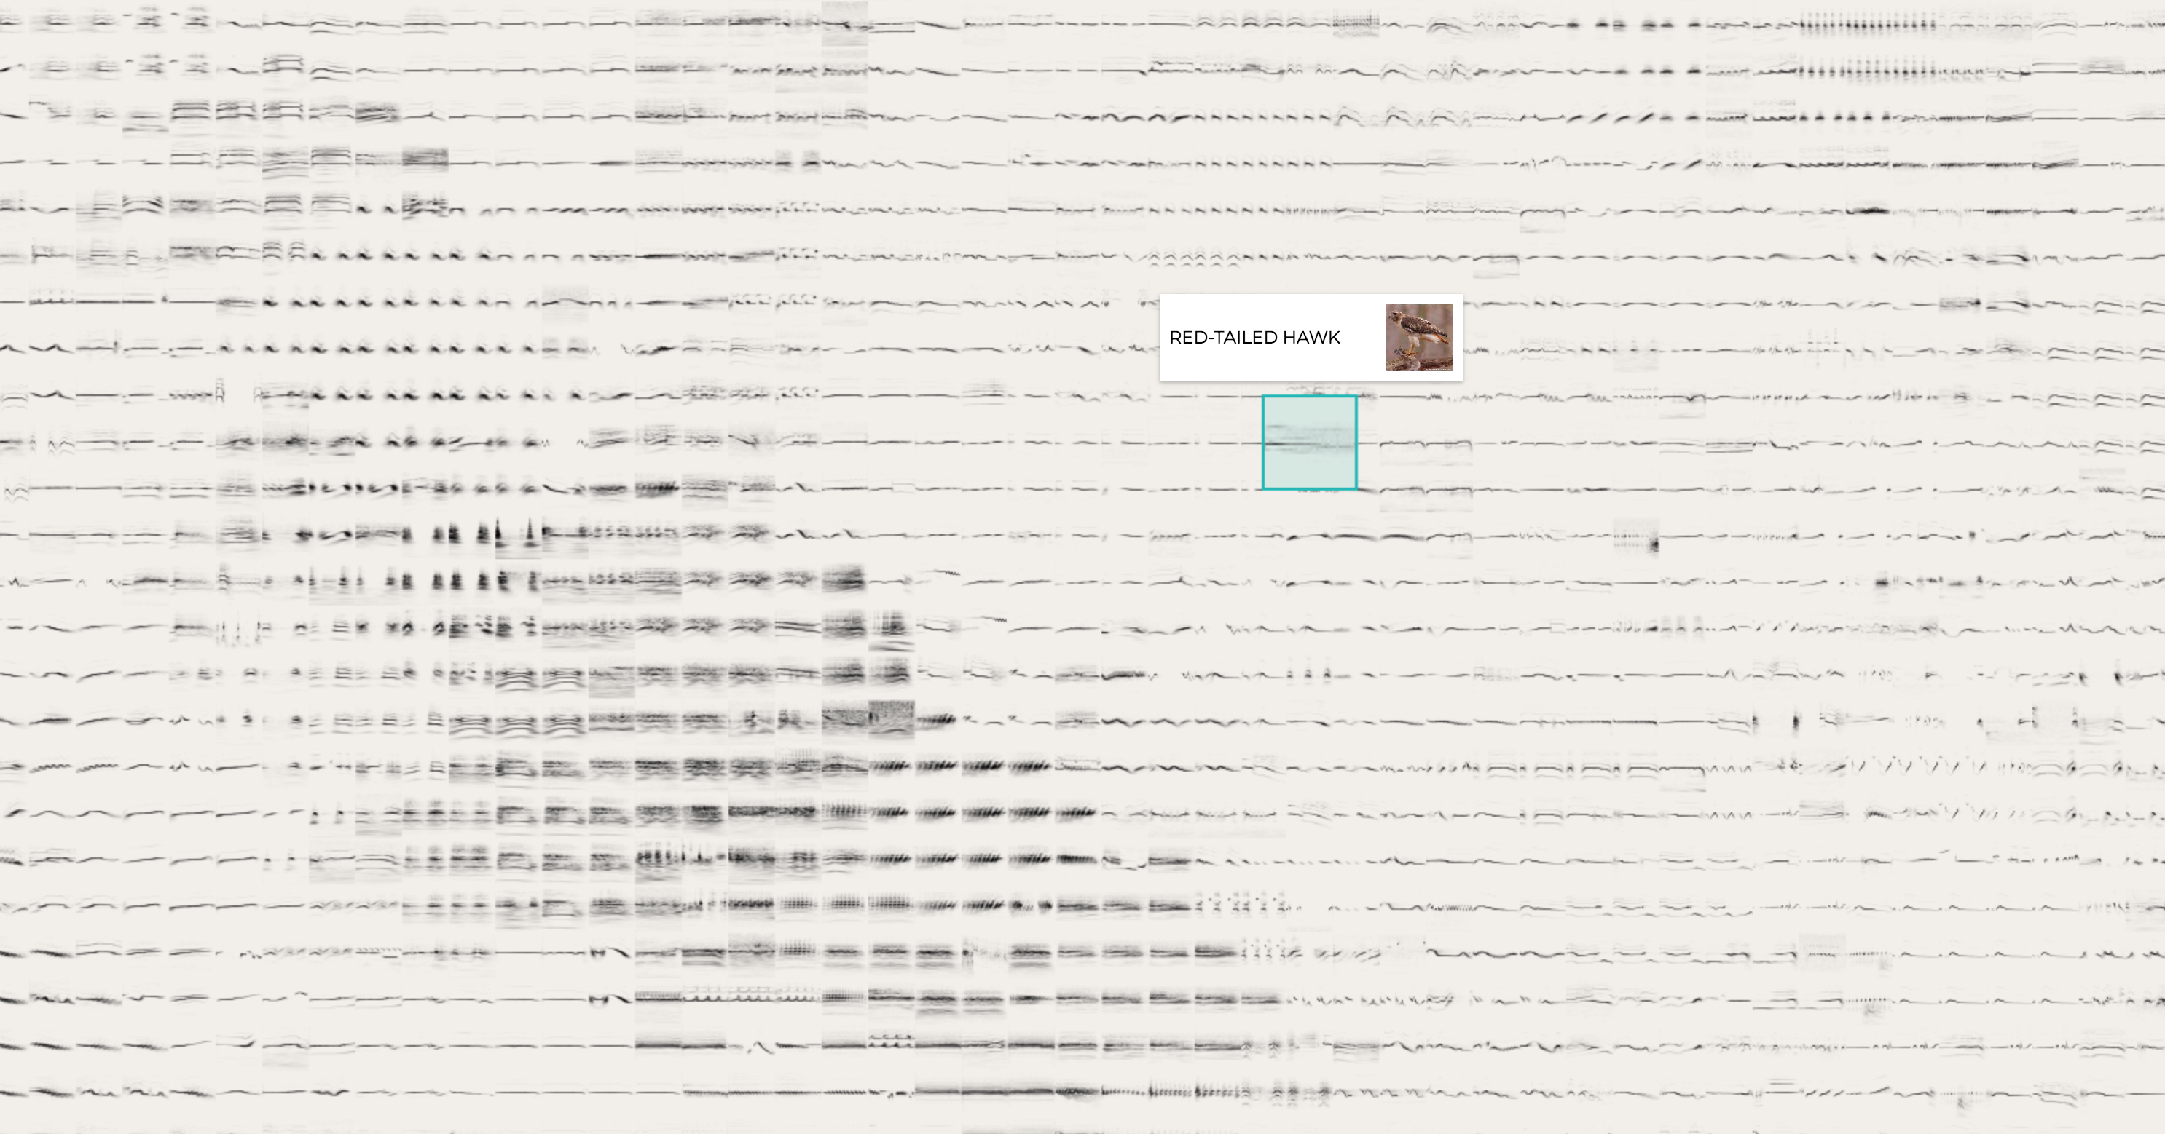
We have over 2k recordings of bird sounds
Visualization showing hundreds of thousands of bird wave calls

Slide 20
Let’s try to identify the bird calls from Kasios
In the known set
Take the bird sound
Turn it into a wav
Turn it into a vector of numbers
Do this for all the bird sounds
Create an equation for BirdA, BirdB, BirdC

Slide 21
Now we have a new bird sound
Take the sound
Turn it into a wav
Get its vectors
Plug it in to the different bird calls and see… what kind of bird is it likely?

Slide 22
Visualization
Interactive process of drag and drop to do manual supervised machine learning

Slide 23
Processing ….

Slide 24
Show the results
Inferred results for the different birds

Slide 25
Let’s listen to a couple of them
Bird call and visualization

Slide 26
Back to our understanding of where the birds live
Show the visualizations of the bird inferred and the location found
Charts Andrew and Aaron created

Slide 27
Only 4 pipets were found!
Here are where the pipets were found

Slide 28
Interactive hypothesis building

